Slide 1
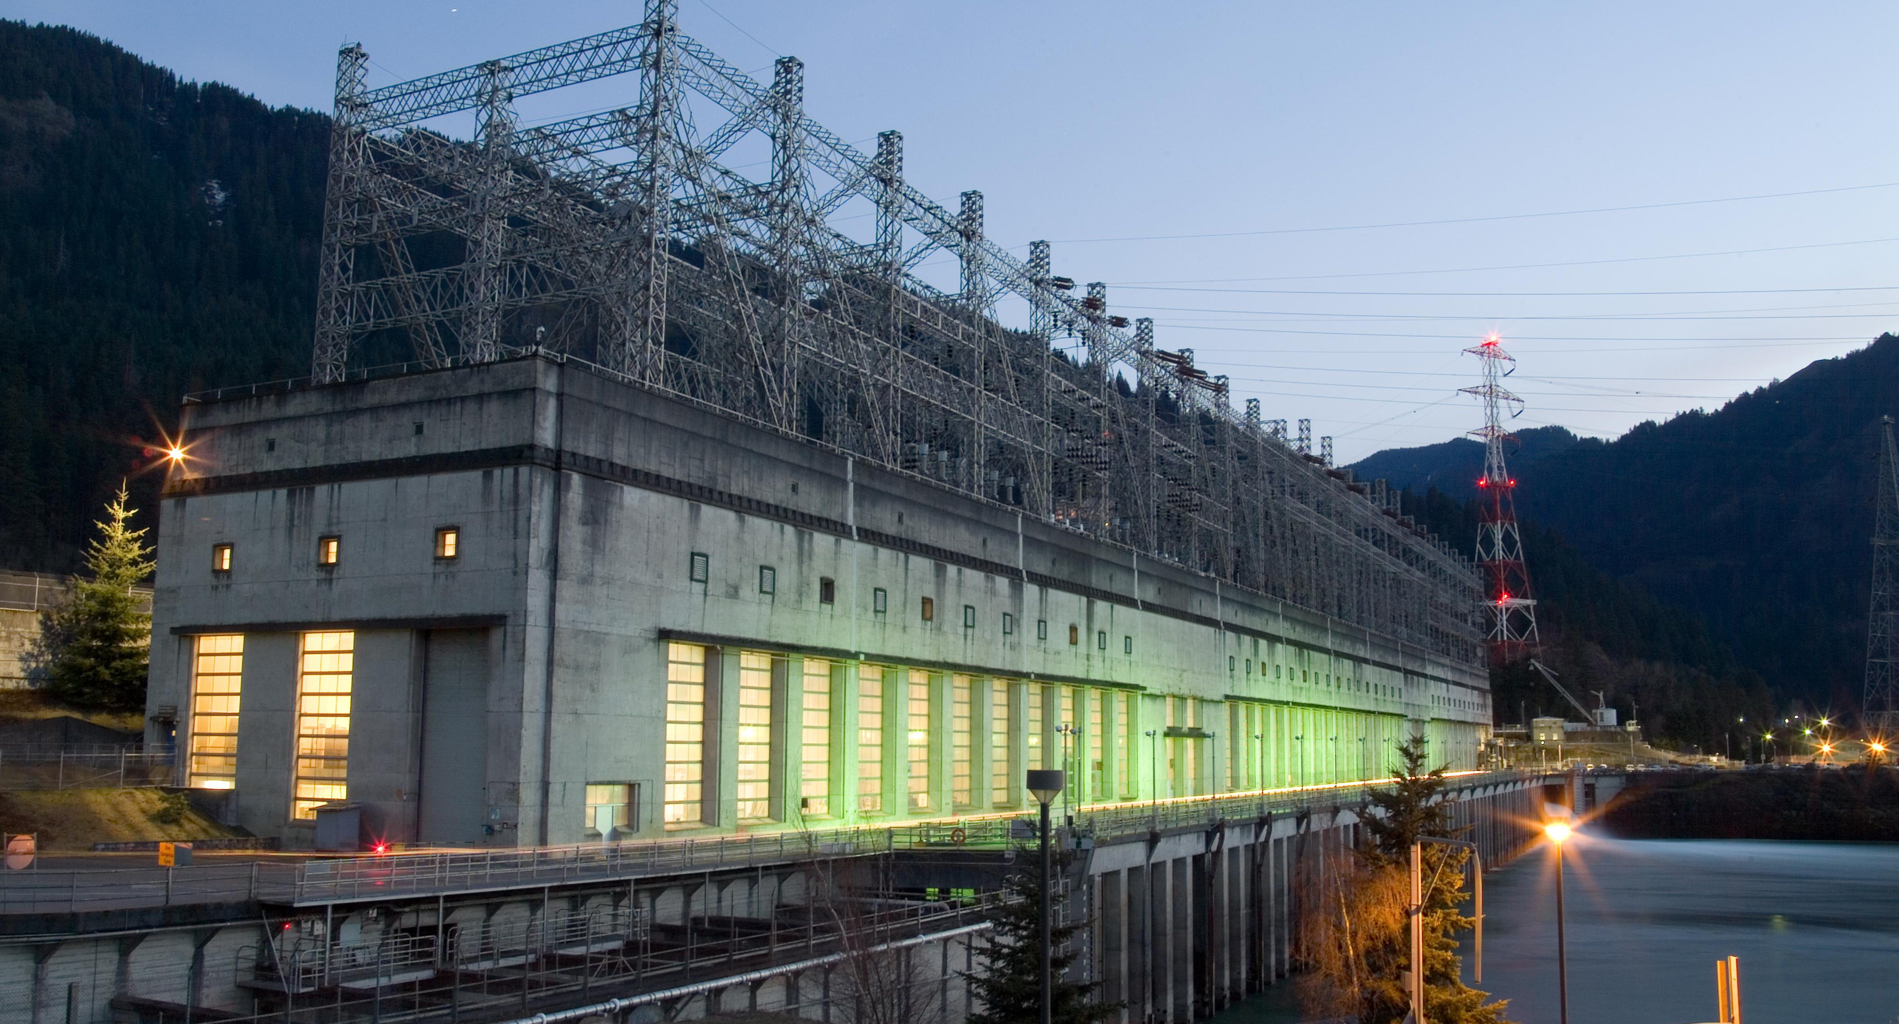
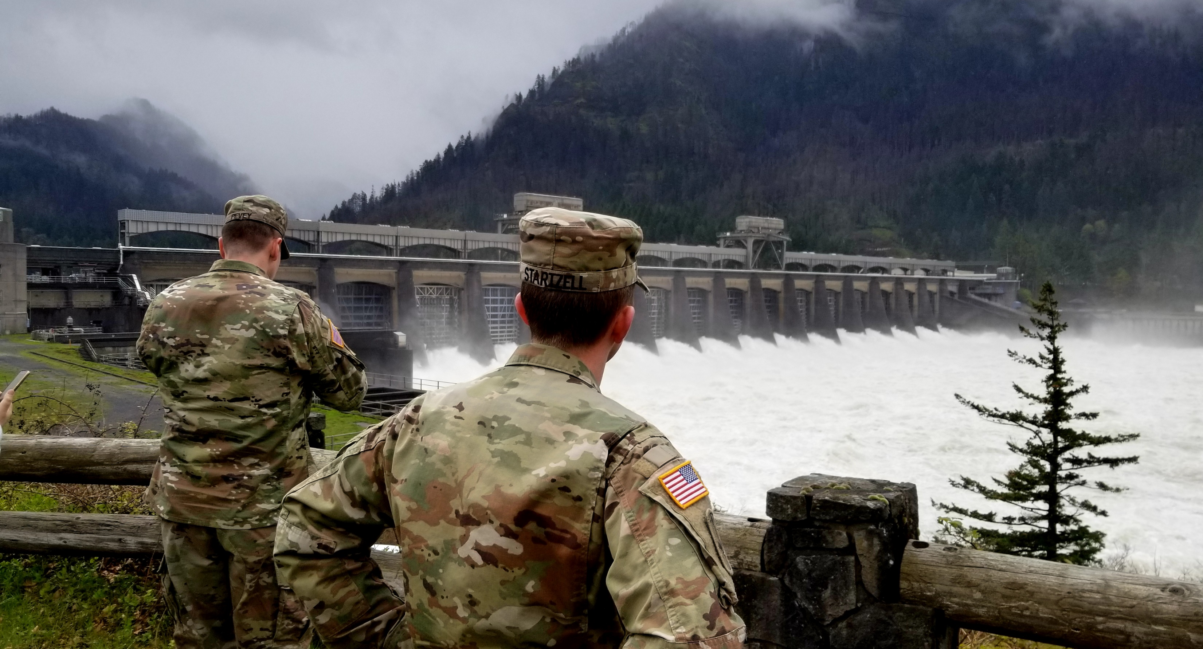
Bonneville Lock & Dam

Slide 2
Risk associated with Bonneville Dam
Consequences
  Loss of Navigation
    Impacts to earthquake recovery
    International-level trade impacts
  Loss of Hydropower
    Bonneville PH1 & PH2
    The Dalles PH
  Loss of Fish Passage
Hazards
  Floods
  Earthquakes
    Grid Resiliency
  Aging Infrastructure
Performance
  Overtopping Breach
  Spillway Reliability

Slide 3
Major Issues
  Gate Splitting and hydraulic bottleneck
    Cranes/Hoists
  Seismic Vulnerability
    Electrical-operability
    Structural-damage to bridge spans over spillbays
Contributing Issues
  Gate Repair pits
  Controls/Electrical
  Crane rails
  Individual Bay Issues (3 in manual right now)
  Bridge Span degradation, esp span B
Issue Evaluation Study (Dam Safety)
  Started on 2017, approaching the finish line.
  Tied closely to MRR, downgraded us to 940kcfs
  Final stretch- DSOG (Dam Safety Senior Oversight Group) briefing at HQ
    Recommendations forward determined
Impact from spill
  Erosion (downstream banks)
  Rock Removal

Slide 4
Bonneville Lock & Dam – page 1 of 2
Component | Operational Status | Condition / Issue | Short Measures | Long Term Actions
Spillway System |  | Seismic Resiliency, O&M reliability Inability to pass flows >940,000 cfs prior to overtopping known low project elevations (inability to split gates) Spillway power, unwatering pumps and other critical equipment are controlled by a single system (PLC interfaces). The current system is past its useful life and spare parts can no longer be procured. Failures will result in loss of remote monitoring and control of one or more bays. | Complete Issue Evaluation Study (IES) - Estimated Q4 FY23 | Replace/Modernize Spillway OPTO Control System Major Rehab Evaluation
Spillway Gates | OCA = D Currently in Service | Inability to perform maintenance / inspection Pitting / corrosion / coating failure |  | Major Rehab Evaluation
Hoisting Equipment | OCA = D In Service w/ restrictions | 10 "1st Generation" hoists from 1971 have inadequate braking systems. Two failures have occurred resulting in uncontrolled dropping of gates. | Increased maintenance / inspections. | Hoists have planned Phase 1A/MMR start in FY24. P&S funding submitted for FY25 (not ranked in Top 75) Major Rehab Evaluation
Gate Repair and Storage Pit (GRASP) | Out of Service | Gate maintenance has not been performed since 2003 due to: Inadequate access to the gates Inadequate weather protection to perform work in the pits Inadequate ventilation and lighting for workers in the pits |  | GRASP requires new lighting, a new HVAC system, and a new drainage system. The deck above will need to be sealed from the weather, and new scaffolding is required. Means of seismically restraining spillway gate leaves is also required. Design/Build contract for FY24.
Spillway Gantry Cranes | OCA = D Currently in Service | Wind loads cause stress in frames above allowable limits. Electrical bus has failed. Used to enable proper spill patterns. Can't achieve spillway capacity (i.e. split gates) w/o cranes. Only one gantry crane equipped with lifting bridle to move gate hoists. | Replace Cranes – P&S in progress. Construction package submitted for FY25 (#4 Rank in NWD) | Major Rehab Evaluation
Stilling Basin | ?? | Entrainment of rocks in the stilling basin and apron causes ongoing erosion and requires regular rock removal (annual?) | Remove all rocks and debris to prevent erosion or undercut – in FY24 PBUD | Construction of a jersey style barrier placed onto the spillway apron to prevent rocks from migrating – submitted for FY25 and FY24 Workplan

Slide 5
Bonneville Lock & Dam – page 2 of 2
Component | Operational Status | Condition / Issue | Short Measures | Long Term Actions
Fish Screens | OCA = C | Submerged Traveling Screens (STS) need major overhaul (corrosion, bearings, etc.) |  | Complete overhaul is needed
Adult Passage |  | Many fishway components such as control systems, conduits, valves and diffuser gratings are aging and are at risk of failing. Spare parts are often unavailable. Fish elevators are non-functional, have not been used in at least 50 years, and are an environmental and safety hazard. Environmental issues due to potential oil spillage. Also, may have wooden bulkheads that could fail. Original AWS conduits have excessive water leakage causing sinkholes along fish ladders (A-branch, B-branch, Cascade Island) | Emergency riprap repairs have occurred in last few years due to erosion. | Update/replace system components (comprehensive list of aging/failing fishway system items is available) Remove spillway fish elevators
Misc |  | The Fish Field Unit (FFU) trailer is reaching the natural end of life. One option is to build out the Juvenile Monitoring Facility (JMF) with modular offices and move FFU there. This will keep FFU behind secure gates and reduce Corps presence on the peninsula (which may help with hatchery disposal at some point in the future). |  | JMF build out - office space for FFU + Dive
Spillway Bridges | OCA = F (Decking, Supports, Concrete, Steel) | Bridge B (Viaduct Bridge) in poor condition and now equipped with “temporary” steel span. Steel span prohibits large vehicle or flatbed access. Bridge D (GRASP): 11-ton vehicular load prohibits heavy vehicles and 65 ton crane access. Bridge spans are “at capacity” which prohibits constructing heavier gantry cranes or spillway gates. |  | Major Rehab Evaluation Rehab bridges (2019 EDR)

Slide 6
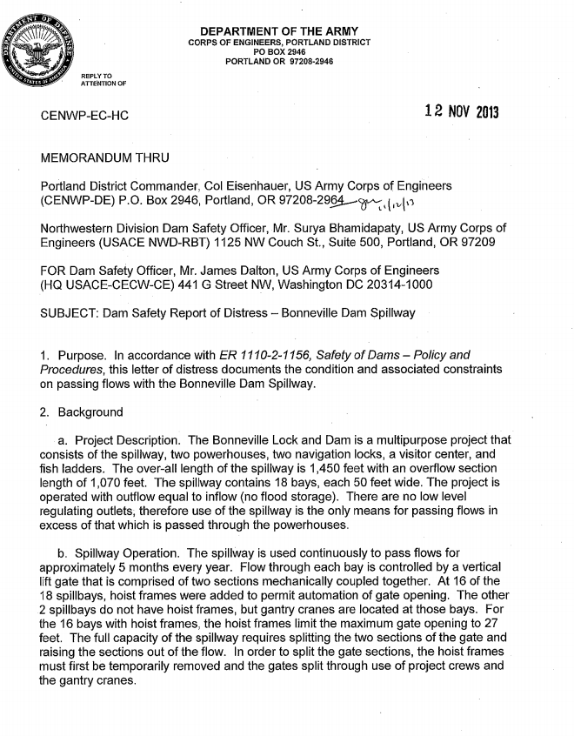
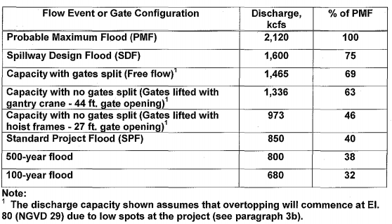
Recent History
2018: MRR Shelved (funding)
The Navigation Lock 1 Swing Bridge was moved to a Major Maintenance Report.
The Fish Ladders were summarized in a Bonneville Fish Ladder Assessment report and return to programmatic funding
The spillway remains in the MRR and is also further being investigated in an IES.
2017: MRR Initiated
Major Rehabilitation
Reinitiate?
Columbia River Treaty Review & Negotiations
2013
2014
2015
2016
2017
2018
2019
2020
2021
2022
2023
2024
2025
Columbia River System Operations (CRSO) EIS
Issue Evaluation Study
2016: IES Initiated
2019: SQRA Completed
Vertical Team: Advance to QRA
No DSAC Memo
2013: Spillway Letter of Distress
Gate splitting unsafe – spill capacity reduced
Do an MRR
Fix the GRASP
Update Flood Fight Plan
IES not prioritized in national queue

Slide 7
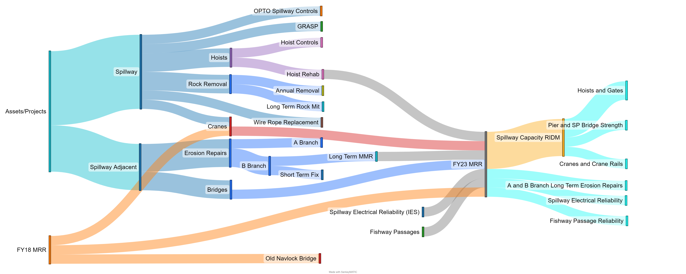
Asset Strategy
Can’t act on much of this until MRR is completed. (except wire rope replacement- funded and scheduled)
20 years out, MRR guided

Slide 8
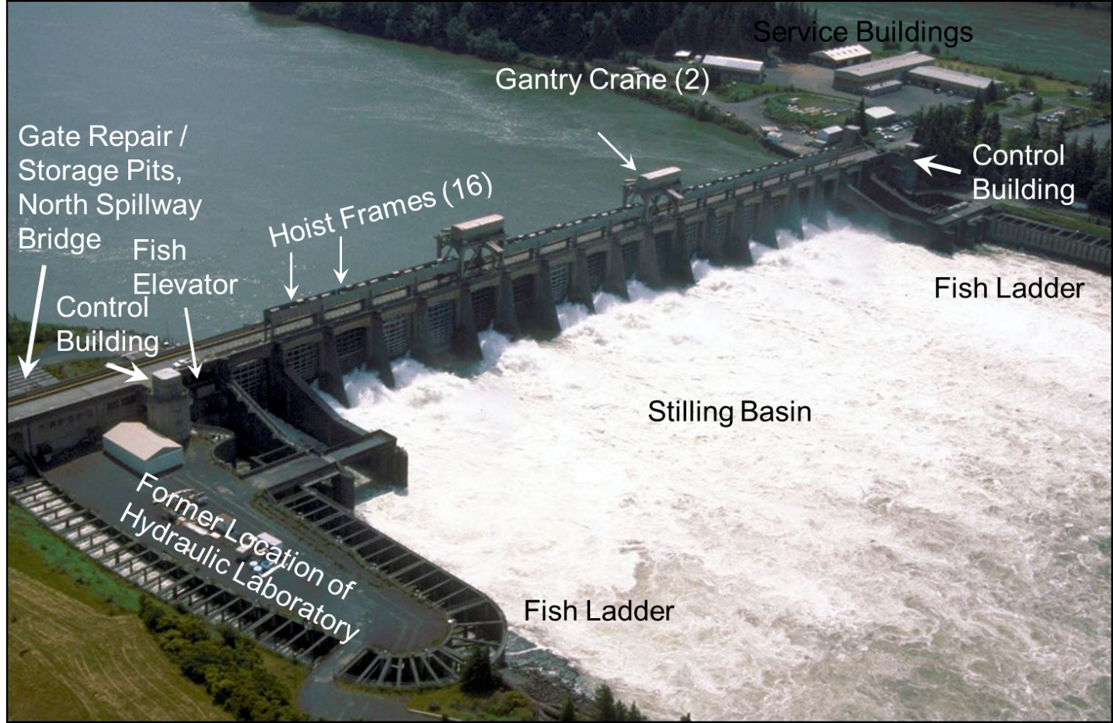
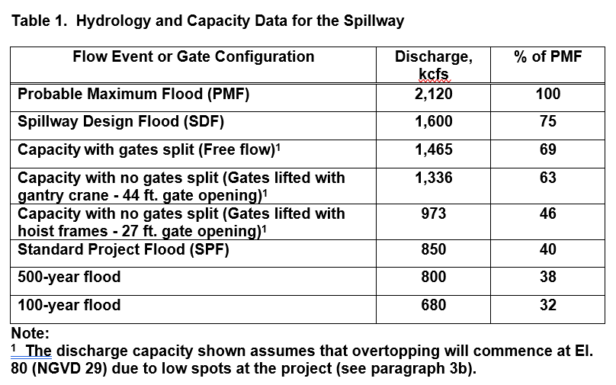
Hydrology
Current understanding is that gates can only be opened to 26 feet open with (2) gates at 44 feet open (not all 18) which is a capacity of approximately 940 kcfs.

Slide 9
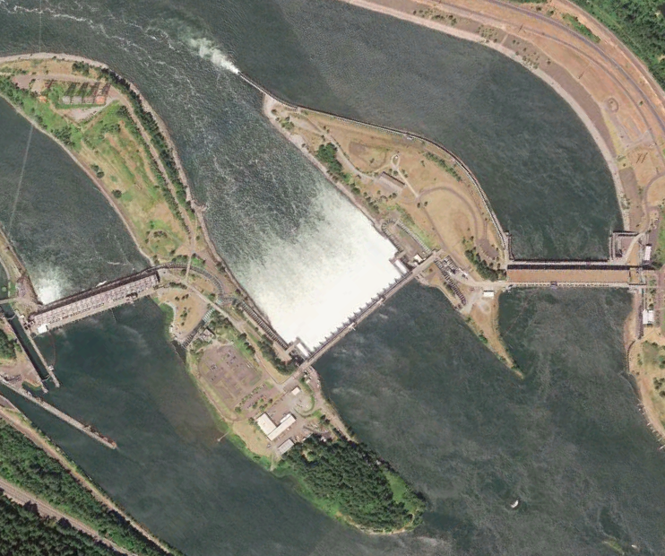
Electrical
-Cranes and hoists fed from both North and South ends
-Limited seismic capacity
-Cranes are not reliable
-Safety concerns
NORTH
WASHINGTON
Robins Island
Bradford Island
Cascades Island
Powerhouse 1
(1937)
Spillway (1937)
Powerhouse 2 (1983)
OREGON
Flow
Lake Bonneville
Notes:
The spillway can be powered from either powerhouse. Availability of power to the spillway is not dependent on the availability of power from the grid. Spillway power is dependent of the availability of the station service power and the integrity of the power distributions system.
Again, powerhouse 1 and 2 can provide power to the spillway. However, only powerhouse 1 is capable of black starting. Powerhouse 1 station service Unit O can provide power to station service including the spillway. Powerhouse 1 Units 3 and 4 can run station service, but cannot black start. Powerhouse 2 fish units have been tested to run station service, but cannot black start. However, the fish units can run islanded and feed the spillway if they don’t trip during a seismic event. Fish units in powerhouse 2 do not have black start capabilities and there are no approved plans to make them black start capable.
The fragility and restoration curves from HAZUS were used to estimate the probability of failure for black starting the powerhouse service units. A lognormal distribution for damage was estimated as a function of the PGA. Lognormal distributions for restoration times given a damage state were used to estimate whether the damage to the service units could be repaired by comparing the restoration times to the hydraulic estimates for overtopping the dam.

Slide 10
Gate splitting concerns
  Electrical bus is not reliable, gantry cranes are currently operated from generators
  To fuel the generators, a contract would need to be set up with a fuel company (not currently in place)
  Reliability of infrastructure as a whole. A majority of the project components are original to construction of the project in the 1930’s
  Deck panels have to be removed to the south due to load restrictions on the north fish passage bridge
  Only one gantry crane has the bridle necessary to move a hoist
  Before initiating the gate splitting process, inflow has to be above 680,000 cfs to provide protection for the stilling basin which limits the time we have to be able to successfully split gates
  Significant concern around detaching the hoist lifting beam from the gate

Slide 11
Two Paths Forward
Major Rehabilitation Evaluation
  Paused due to funding
  Restart in 2024- funded
Dam Safety
  Being presented at USACE HQ in November. (DSOG)
  Issue Evaluation Study
    Started in 2017, approaching finish. Tied closely to MRR.
  DSOG could recommend a Dam Safety Modification Study
    More than just rehab

Slide 12
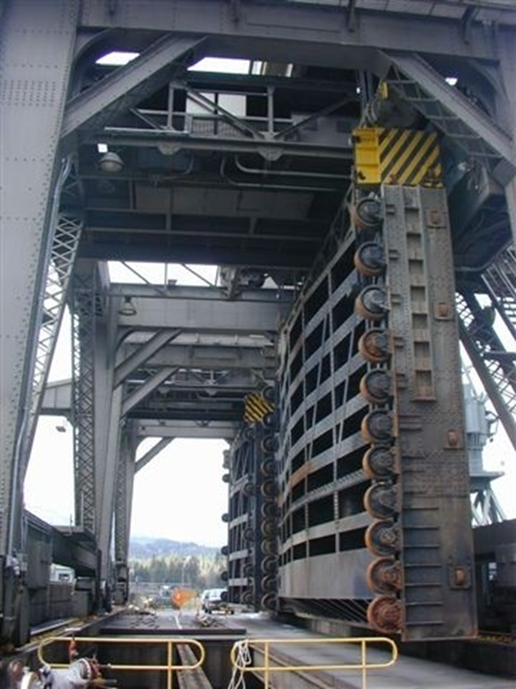
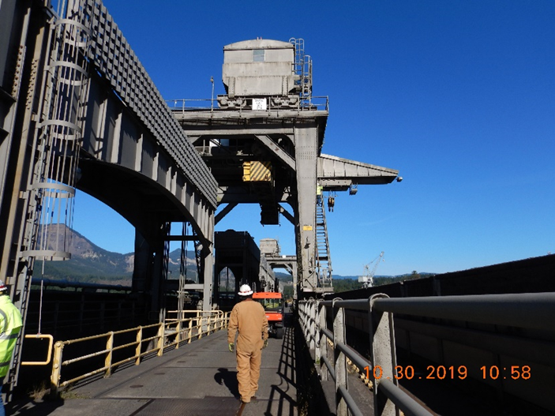
Cranes
  Nearing “End of Life”
  Large cap- in progress. Went through phase 1A, began design process in 2023 (several years, then construction contact)
  Contract in the works is to rehab, not replace (extend life for ~20 years), funded by Large cap above.

Slide 13
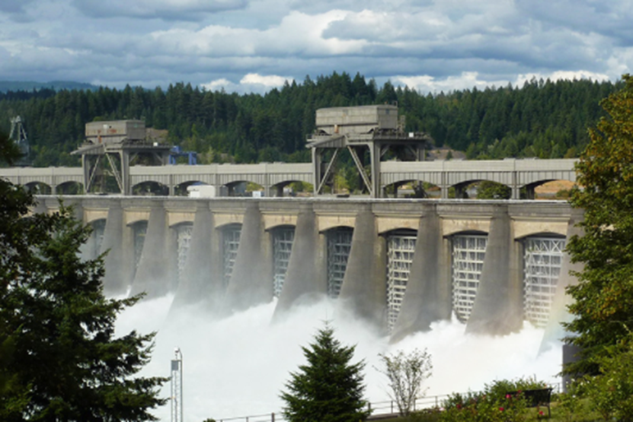
Hoists
Originally built with single brakes, these have failed.
Wire replacements are scheduled for next year (routine funding)

Slide 14
Gate Repair Pits
  Repair pits do not meet numerous safety codes and cannot be utilized.
  Gate have not been serviced in ~25 years.
  Scheduled rehab has not been occurring (climbing inspections on TW side and ROV on FB side have occurred)
  Contractor bids have come in over budget, so specs were revised and expect contract award FY24.

Slide 15
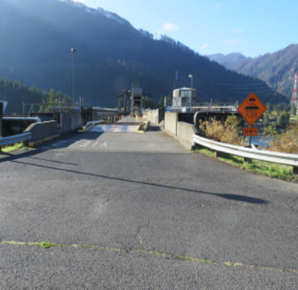
Bridge Spans
One section of Bridge span (B) is particularly deteriorated, limiting weight capacity.
  Weight capacity limited to 11 tons
  65T mobile crane cannot transport over spillway
  Other spans also have weight restrictions
Temporary steel bridge installed over Span B is nearing end of life.
  Installed in 2011 after Span B was closed to all traffic.
  Plan forward is encompassed in MRR/large cap projects.

Slide 16
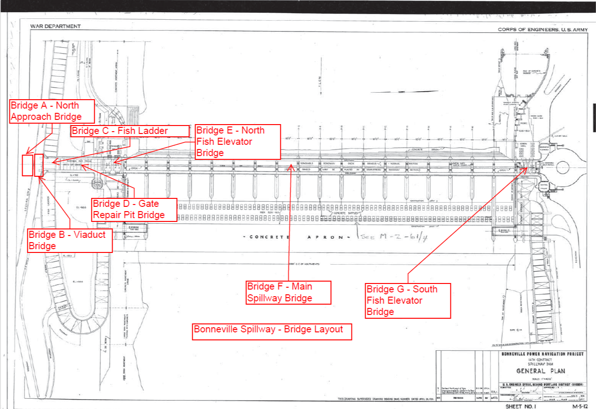
spillway bridge spans repair – Continued

Slide 17
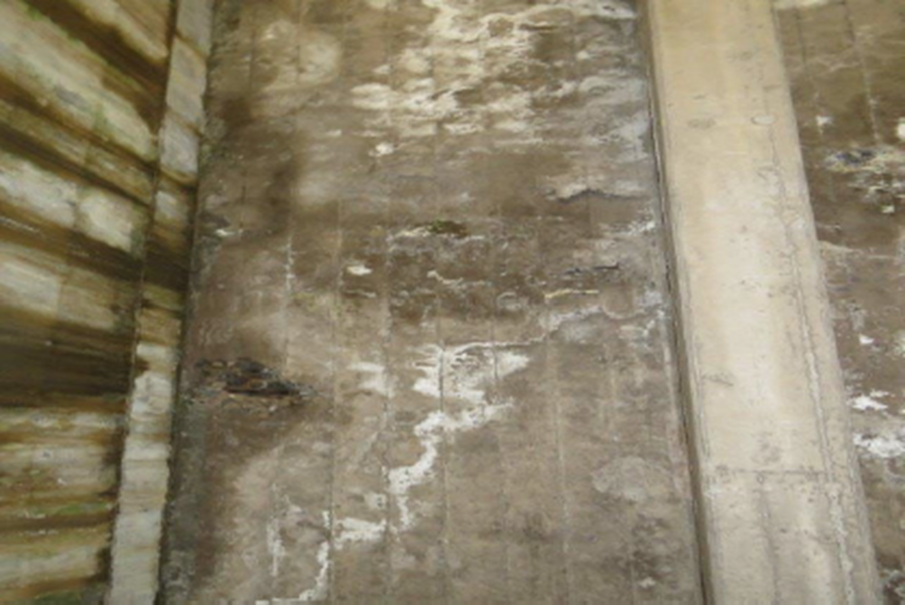
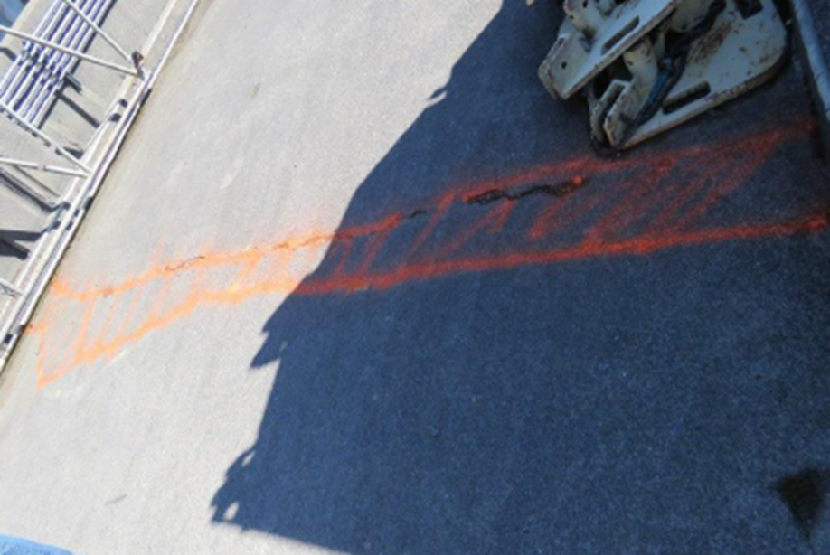
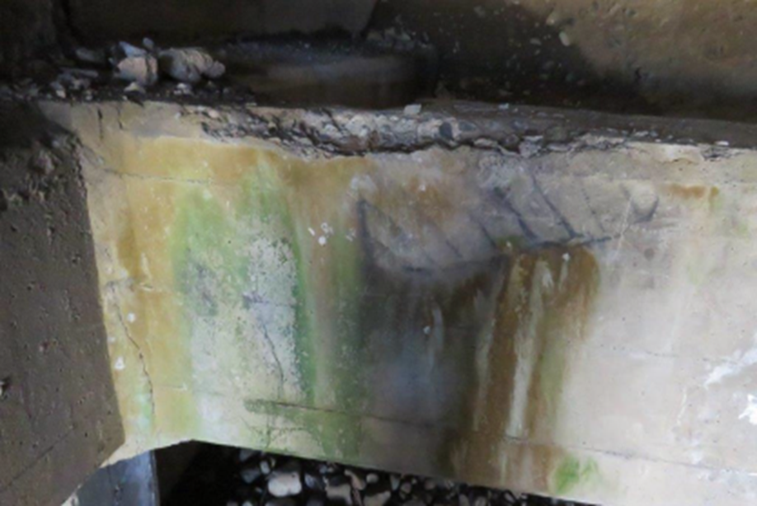
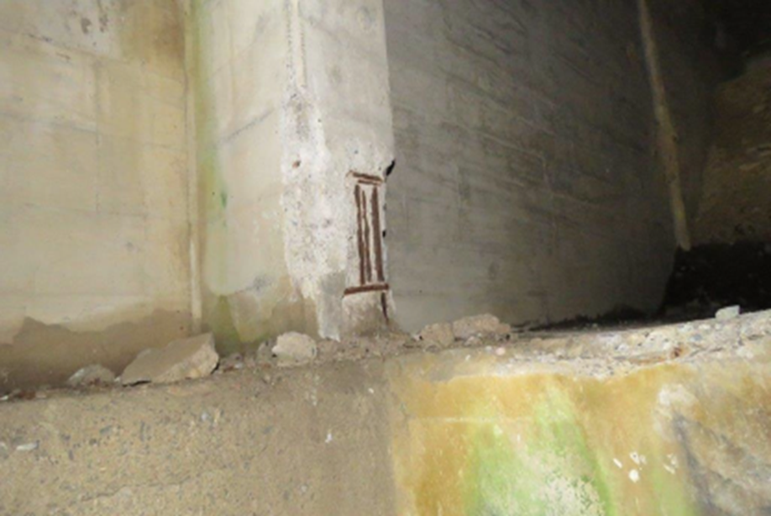
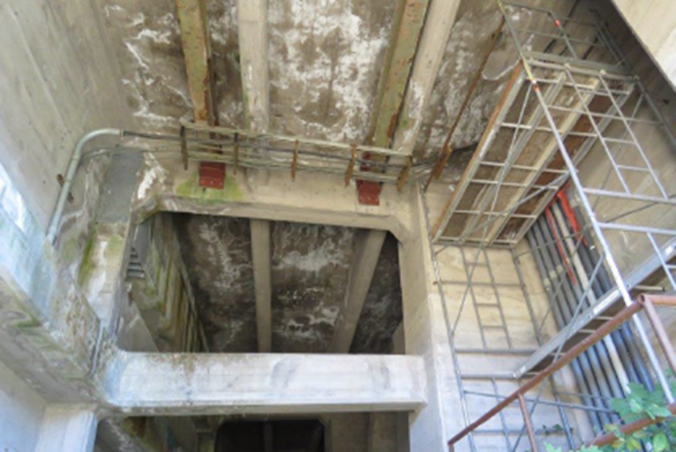
Bridge Span B

Slide 18
Other
Controls-
  Adult Passage: The current control system is past its useful life and spare parts can no longer be procured. Failures will result in loss of remote monitoring and control.
  Small cap and Large cap requests submitted.
    Small cap is for PLC’s and comm network (repair). ~6 years, fate unknown
    Large cap is for hoists/ braking systems. (see slides for dates). Needs to coincide with gate replacement.
  Bays 6, 14 and 17 all in manual but to be fixed once spill ends.

